Slide 1
Child Mortality Analysis
Brian De Villa, Matthew Jankowski, Katherine Misyutina, Abhi Shah
Abhi Shah, Brian De Villa, Katherine Misyutina, Matthew Jankowski

Slide 2
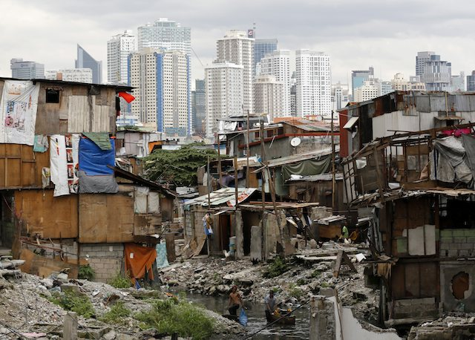
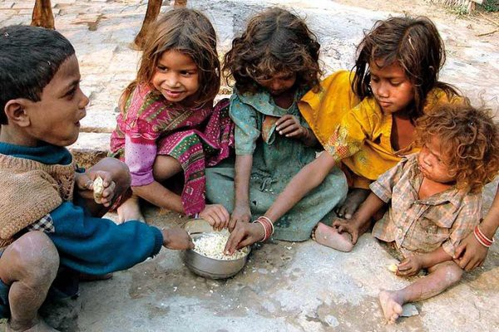
Questions
How does child mortality rate relate to development in countries worldwide?
How does child mortality of measles compare to other diseases?
What kinds of diseases are highly linked to underdeveloped and developing countries compared to developed ones?
Notes:
Right picture:
https://medium.com/@malwarwick_98471/third-world-poverty-and-economic-development-a-reading-list-987fe81bf439
Left Picture:
https://highschool.latimes.com/notre-dame-academy/third-world-vs-developing-country-why-neither-term-is-right/

Slide 3

Hypotheses and Predictions
Countries with lower child mortality rates have a higher Gross Domestic Product.
Countries that have had a large increase in Gross Domestic Product over the past 2 decades had a large decrease in child mortality.
Poor countries such as African nations, India, and Haiti, have the highest amounts of cases.

Slide 4
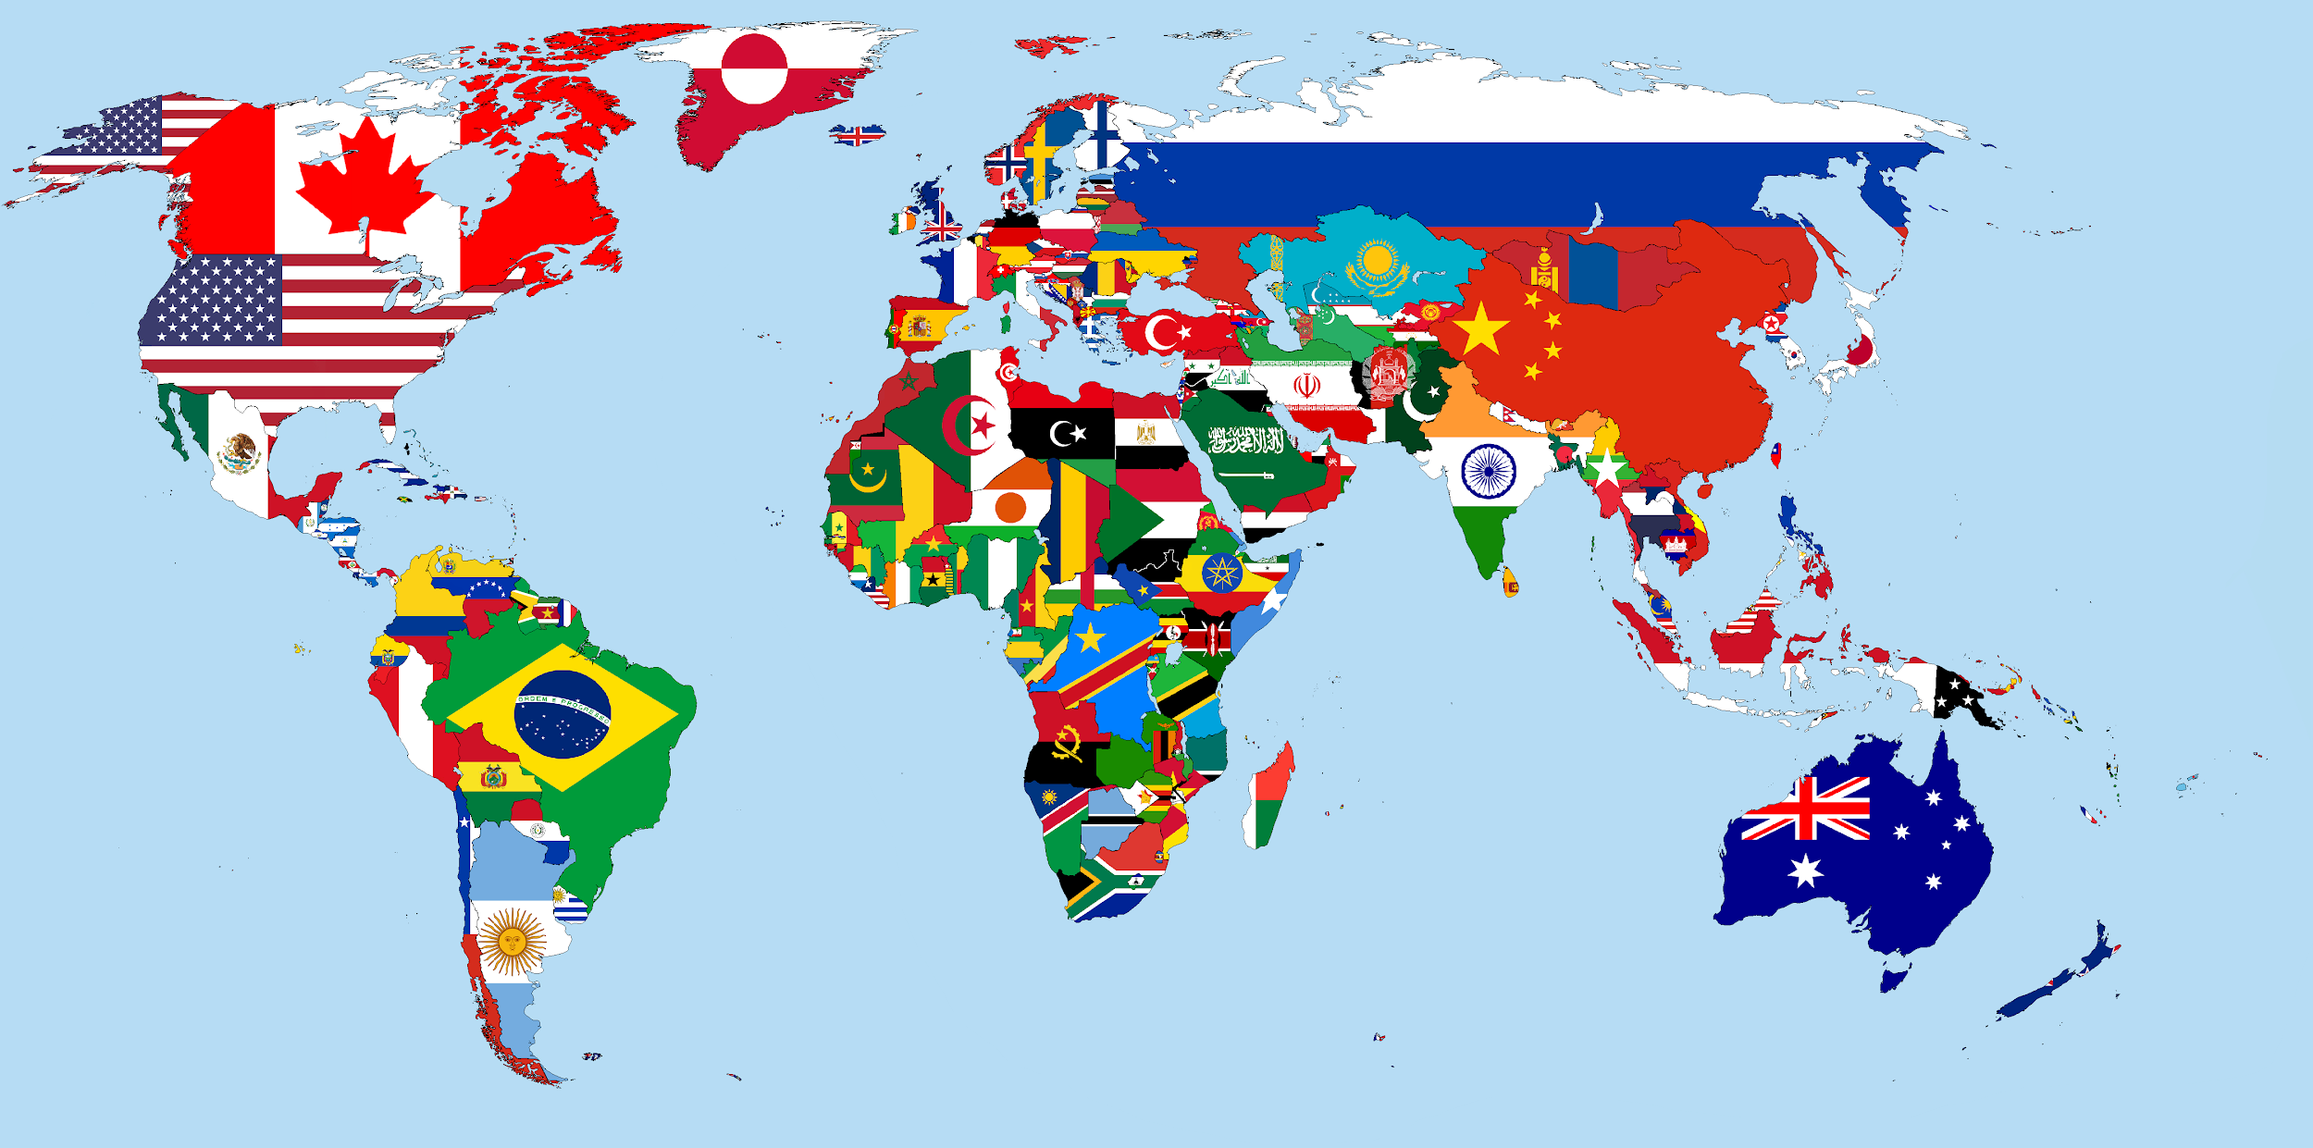

Strategy
Choose sets of countries with diverse GDP from different continents
Choose 5 sets of data related to child mortality due to diseases and infections
Compare the results over time (2000, 2005, 2010, 2015)
Notes:
Right Picture:
https://www.thegreatcourses.com/courses/an-introduction-to-infectious-diseases.html
Left Picture:
https://commons.wikimedia.org/wiki/File:World_Flag_map.png

Slide 5

Challenges
There were some countries that were picked initially that had missing data from the years we were observing
Going back to cleaning / refining the data again before plotting the data because the data wasn’t set correctly
Notes:
Right Picture:
https://amitkalantrimagic.com/2018/01/23/best-corporate-magician/

Slide 6
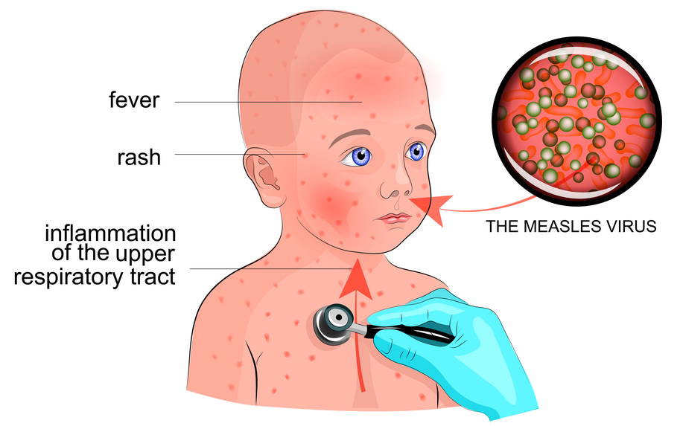
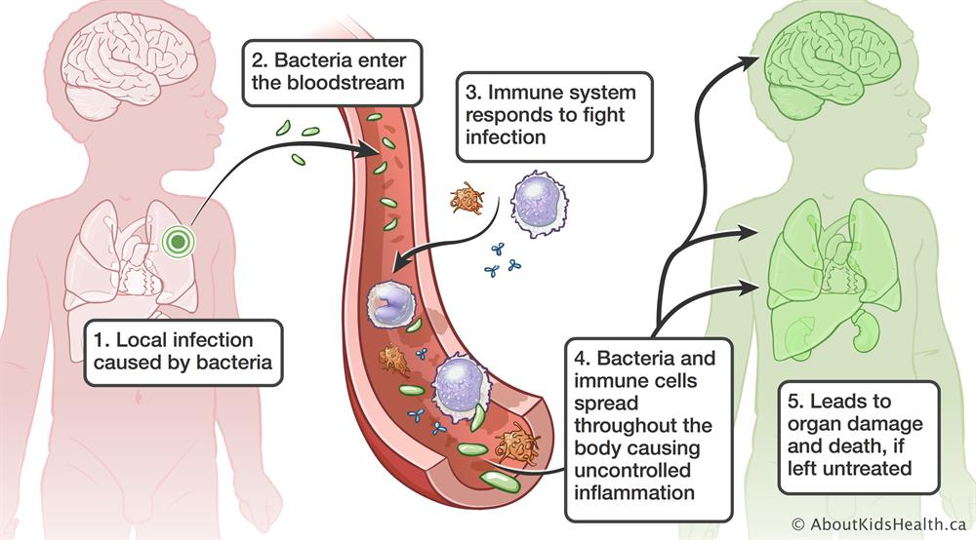
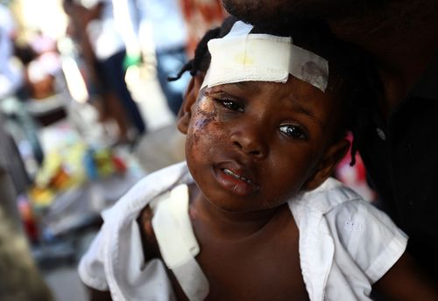
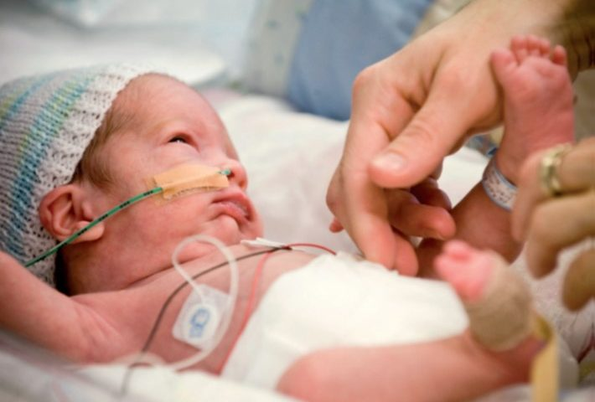
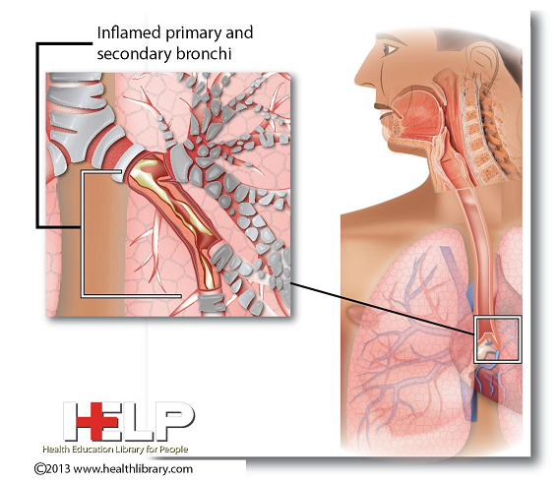
Measles
Sepsis
Acute Lower Respiratory Infection
Injuries
Prematurity
Notes:
Image urls cited:
https://babyhintsandtips.com/wp-content/uploads/2018/03/measles-in-children.jpg
https://assets.aboutkidshealth.ca/akhassets/sepsis_development_EN.jpg?RenditionID=19
https://sites.hss.univr.it/sldlab/wp-content/uploads/2018/10/Research-Project-1-710x480.jpg
https://i.pinimg.com/originals/d2/f5/c0/d2f5c0ebb245ff8be3f5f14453171306.jpg
https://savethechildren.typepad.com/photos/images_from_the_field_hai/59300421.jpg

Slide 7
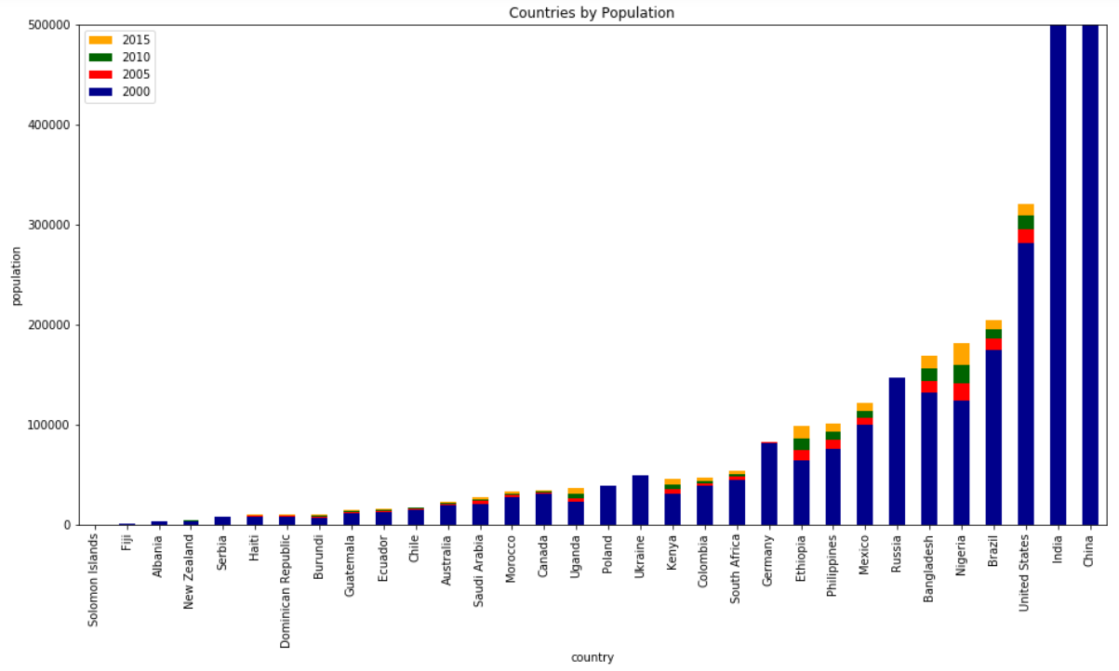
Population of India and China go into the billions.
Notes:
Population

Slide 8
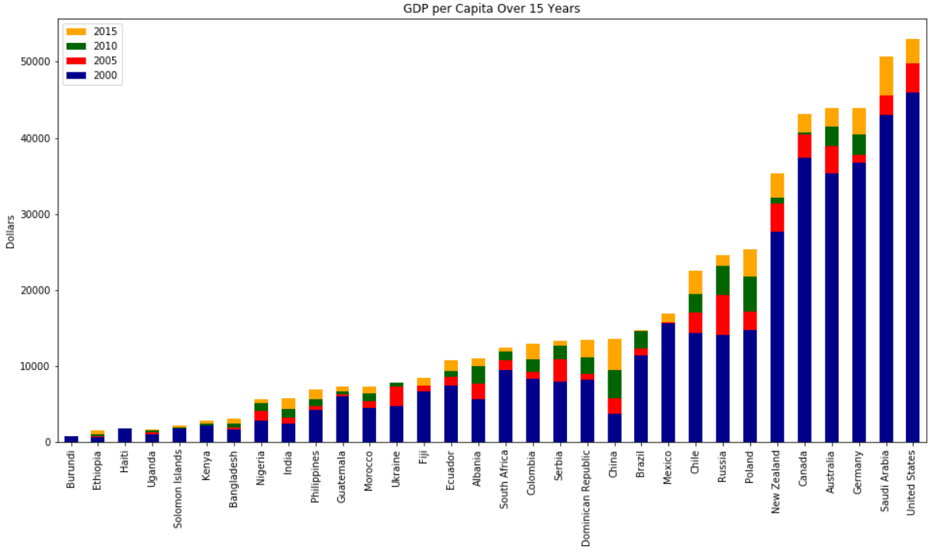
What We Learned (GDP)
GDP per Capita for the 32 observed countries over 15 years:
Notes:
GDP

Slide 9
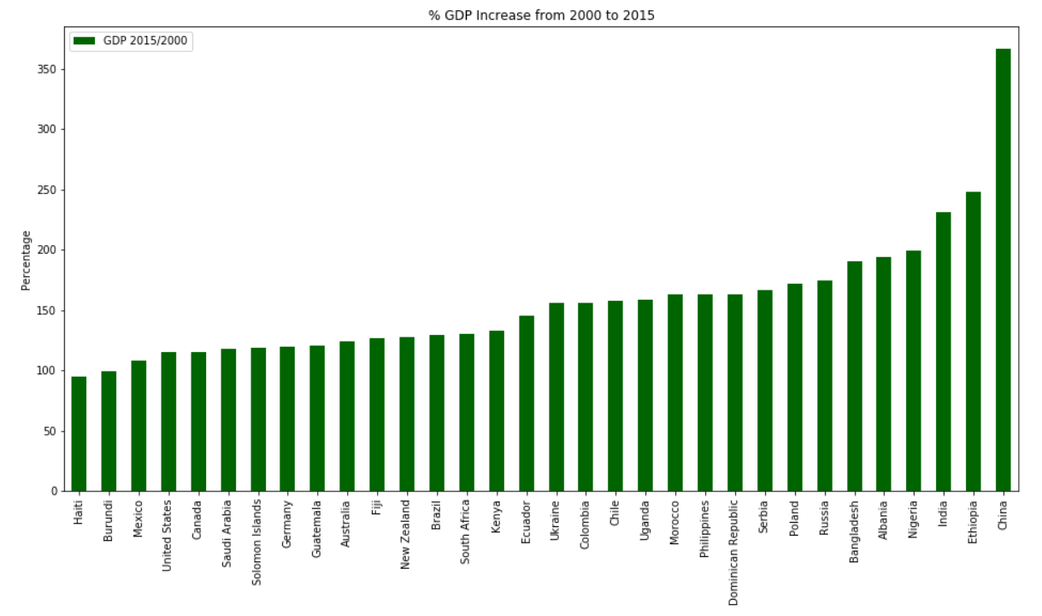
What We Learned (GDP)
GDP per Capita for the 32 observed countries over 15 years:
Notes:
GDP

Slide 10
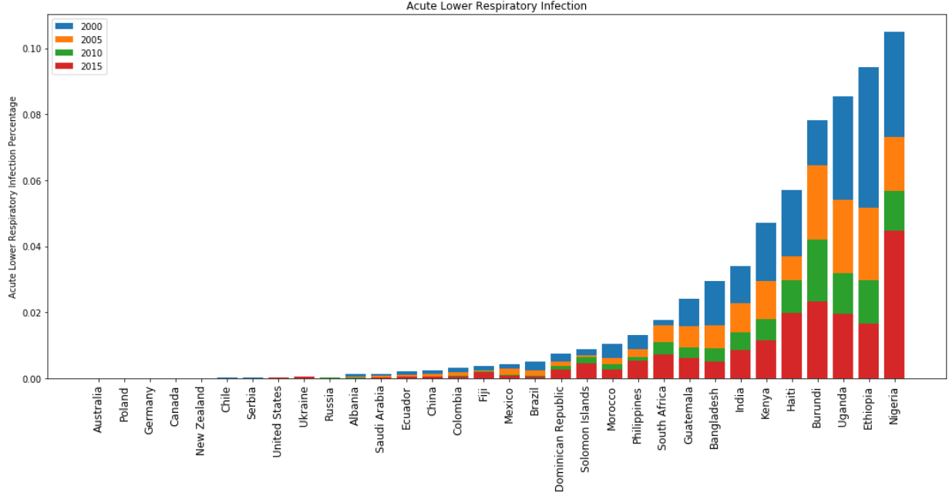
What We Learned
Acute Diseases:

Slide 11
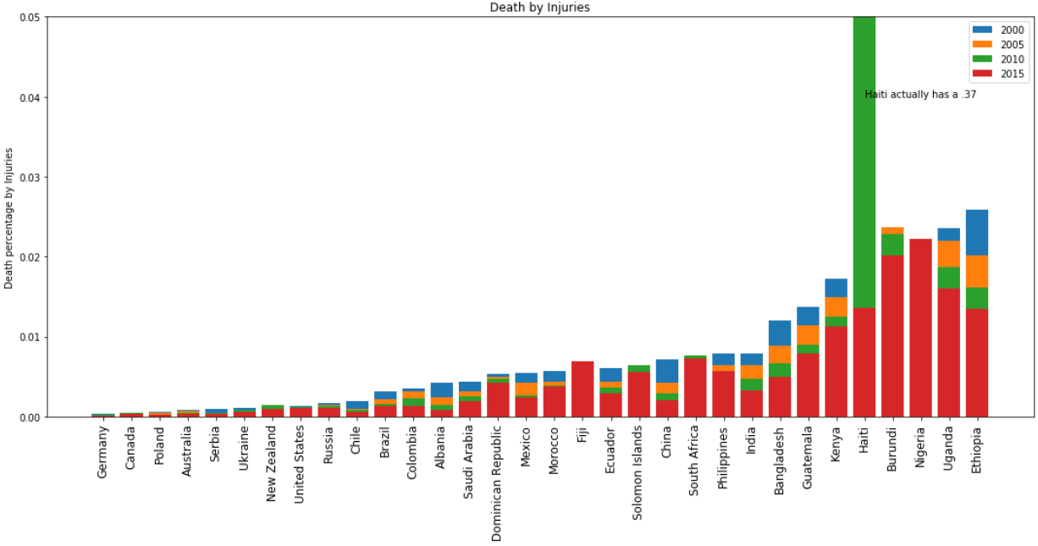
What We Learned
Acute Diseases:

Slide 12
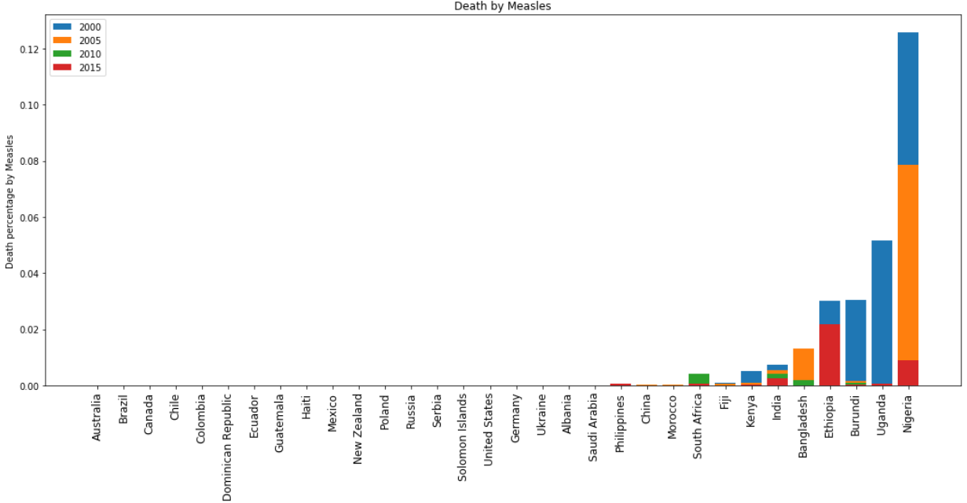
What We Learned

Slide 13
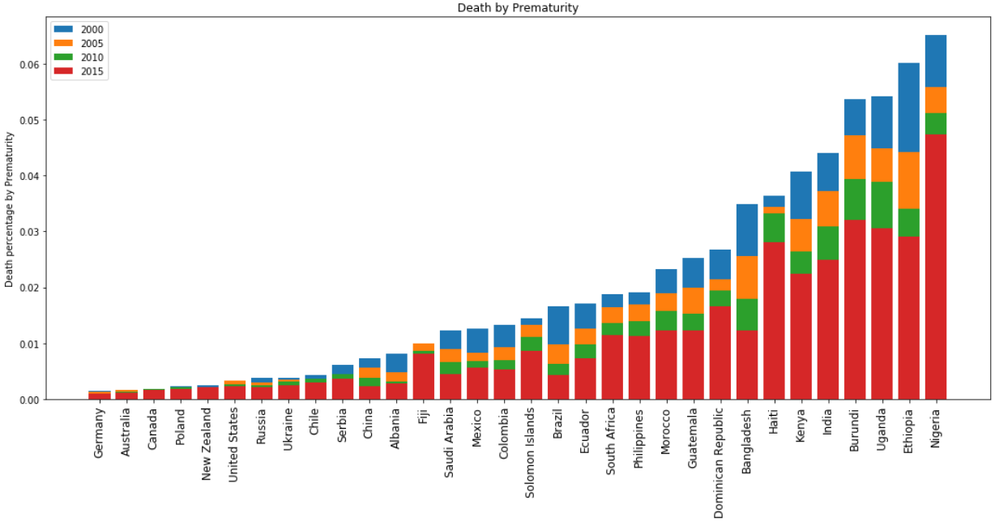
What We Learned

Slide 14
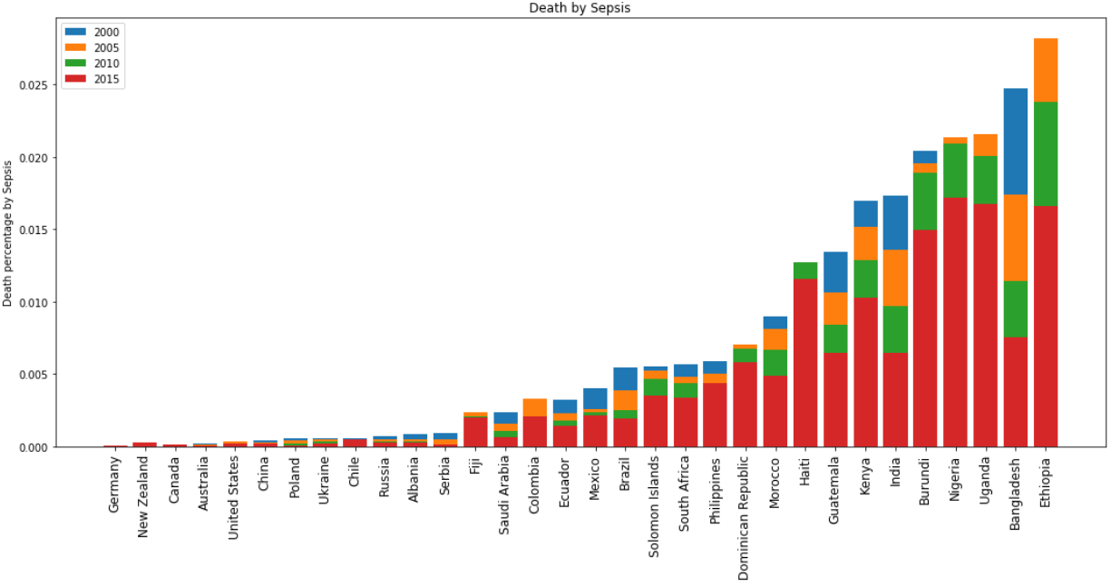
What We Learned

Slide 15
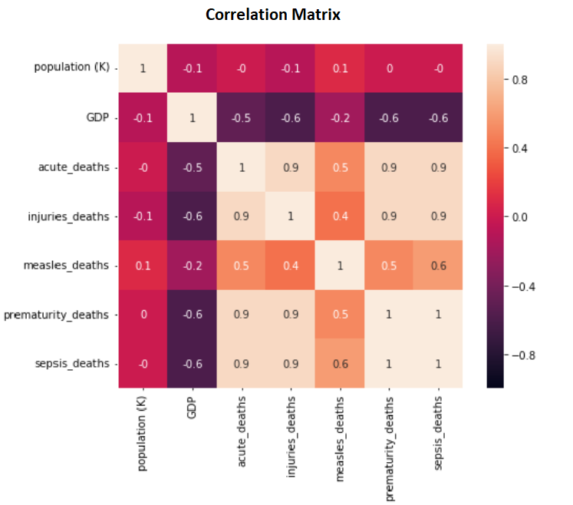

Slide 16
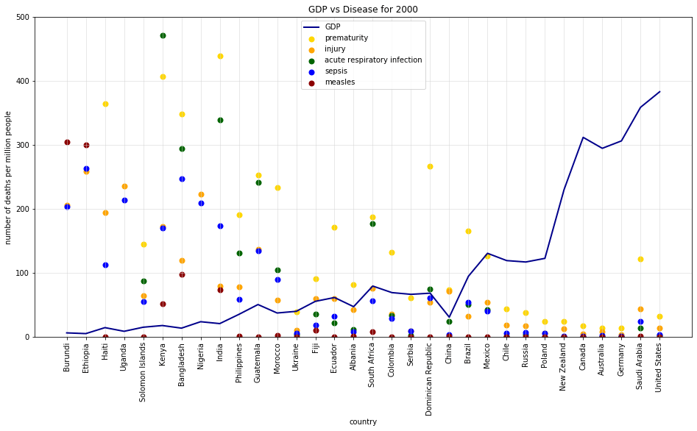

Slide 17
Observations: Nigeria
Nigeria’s GDP per Capita has doubled since 2000.
It has been growing steadily at 7% a year due to their oil industry.
From 2000 to 2015, the child mortality rate has fallen by 50%, but is still very high due to:
Government corruption
Terrorism caused by Boko Haram and ISIS, which cause displacement and famine in many regions.
[Cia World Factbook]
Poverty, with half the population earning less than $2 a day.
Notes:
Right Picture:
https://amitkalantrimagic.com/2018/01/23/best-corporate-magician/

Slide 18
Observations: Haiti and Dominican Republic
Both Haiti and the Dominican Republic have higher child mortality from injury values due to natural disasters devastating the islands in the Caribbean islands
Sept 2004: Hurricane Jeanne kills 3,000 in Haiti (USAID)
Aug - Sept 2008: Hurricanes Fey, Gustav, Hanna, and Ike kills 800 (uFondwa)
Jan 10, 2010: A 7.0 magnitude earthquake hit Haiti, killing approximately 300,000(Encyclopaedia Britannica)

Slide 19
Observations: India
Across 184 countries, the rate of preterm birth ranges from 5% to 18% of babies born.
Almost 1 in 10 babies are born prematurely.
In India, out of 27 million babies born every year (2010 data), 3.5 million babies born are premature. [WHO]
In low-income settings, half of the babies born at or below 32 weeks (2 months early) die due to a lack of feasible, cost-effective care. [HHN]
Notes:
Right Picture:
https://amitkalantrimagic.com/2018/01/23/best-corporate-magician/

Slide 20
Conclusion
How does child mortality rate relate to development in countries worldwide?
Looking at the graphs and correlation matrix, we can note that as GDP increases, child mortality caused by respiratory infection, injuries, prematurity, and sepsis decreases.
Countries with lower GDP lack medical care and resources that developed countries have. Due to this, many infants get sick and die.
Countries with higher GDP have the resources to prevent many mortality cases. For example, Germany has the 3rd highest GDP per capita and has little to no child deaths for disease.

Slide 21
Conclusion
How does child mortality of measles compare to other diseases?
Based on the graph, one can note that 12 out of the 32 countries were affected by the measles while most countries overall have been affected by acute lower respiratory infection, sepsis, prematurity, and various injuries.
Based on the correlation matrix, there is only a slight correlation between the mortality rate of measles and that of other diseases.
Measles seems to have much less cases than the other diseases. Because of this, the correlation is harder to spot.

Slide 22
Conclusion
What kinds of diseases are highly linked to underdeveloped and developing countries compared to developed ones?
According to our results, all the diseases turned out more or less to be more prevalent in developing countries.
Child mortality caused by injury and prematurity are more prominent in developing countries, due to the fact that the other causes are more easily prevented in countries with:
More money to fund medical care
More access to sanitation across the population
More access to clean water across the population

